Slide 1
FIFA FOOTBALL PLAYER POSITION
PREDICTION
Group Members:
Yuchen Song(ys396@duke.edu)
Boyan Zhang(bz106@duke.edu)
Yizhi Wang(yw571@duke.edu)
Baoguanyan Kang（bk220@duke.edu）
1/10

Slide 2

Introduction
Our program will
Give the analysis of the features of a football player
Use two Binary Classification method to predict the positions
Evaluate the result, give analysis, and make improvement

Slide 3

Background
Notes:
As we all know, football is the first sports in the world, and EA company has developed a simulation game called FIFA. Since FIFA game is highly related to real football game, we come up with the idea to predict some features in the FIFA game and apply the result to real world to assist people to make decisions about the players.

Slide 4
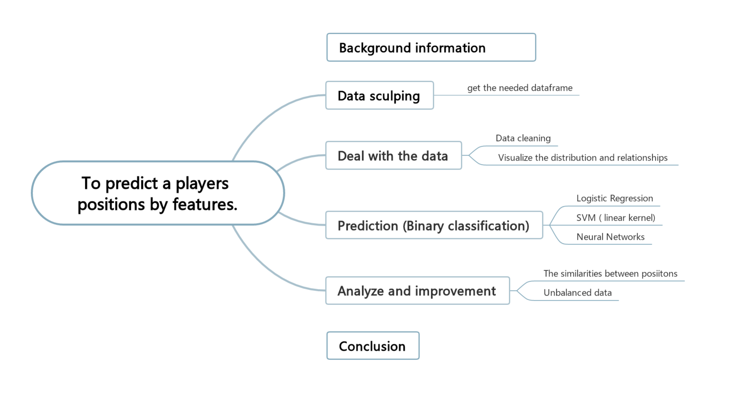
Contents
To predict the players’ positions by features
Notes:
As we had shown in the mid-term review, we are trying to predict the players’ positions by features

Slide 5
Data Sculptor
Beautiful Soup 4 open-source framework
Website structure
Performance optimization
Notes:
In the data sculpting process, we made use of the Beautiful Soup 4 open-source framework and managed to sculpt the information on FIFA players by using the table on the website. We further optimize the performance of the sculptor with a thread pool.

Slide 6
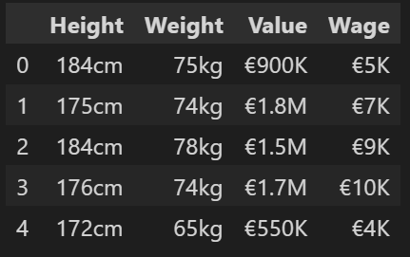
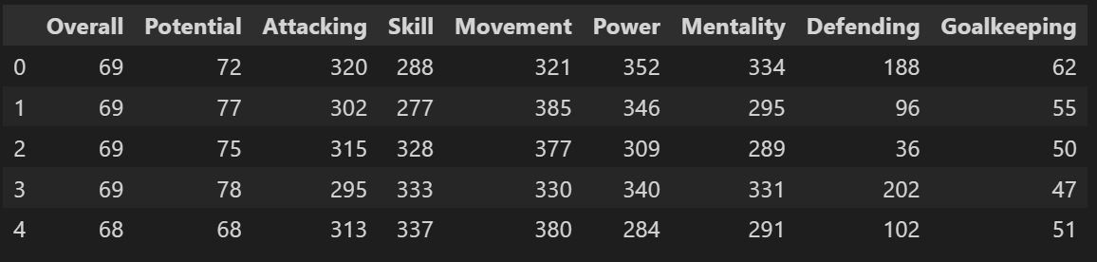
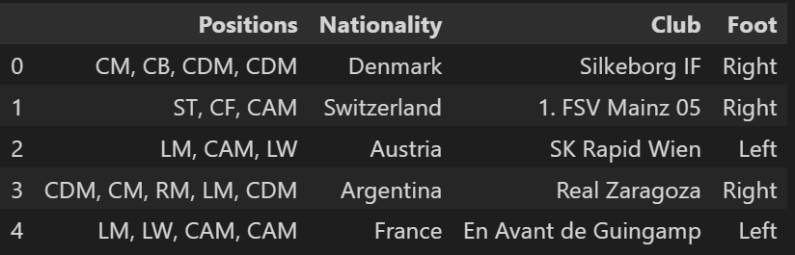
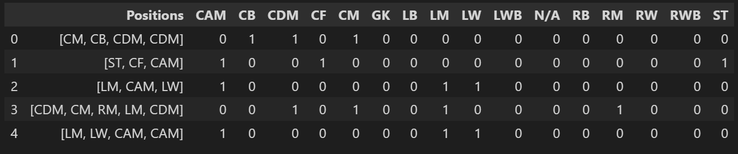
Features
Some of their features
(Height, Weight, Value, Wage)
are measured as integers but with certain units
Most of their abilities are measured as integers on the FIFA website
Some of their features are categorical,
like Positions, Nationality, Club, and Foot.
One-hot encoding for positions
Notes:
Some of their features (Height, Weight, Value, Wage) are measured as integers but with certain units, so we transformed them from strings into integers.
Some of their features are categorical, like Positions, Nationality, Club, and Foot.
most of their abilities are measured as integers on the FIFA website
4. One-hot encoding for positions

Slide 7
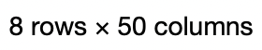
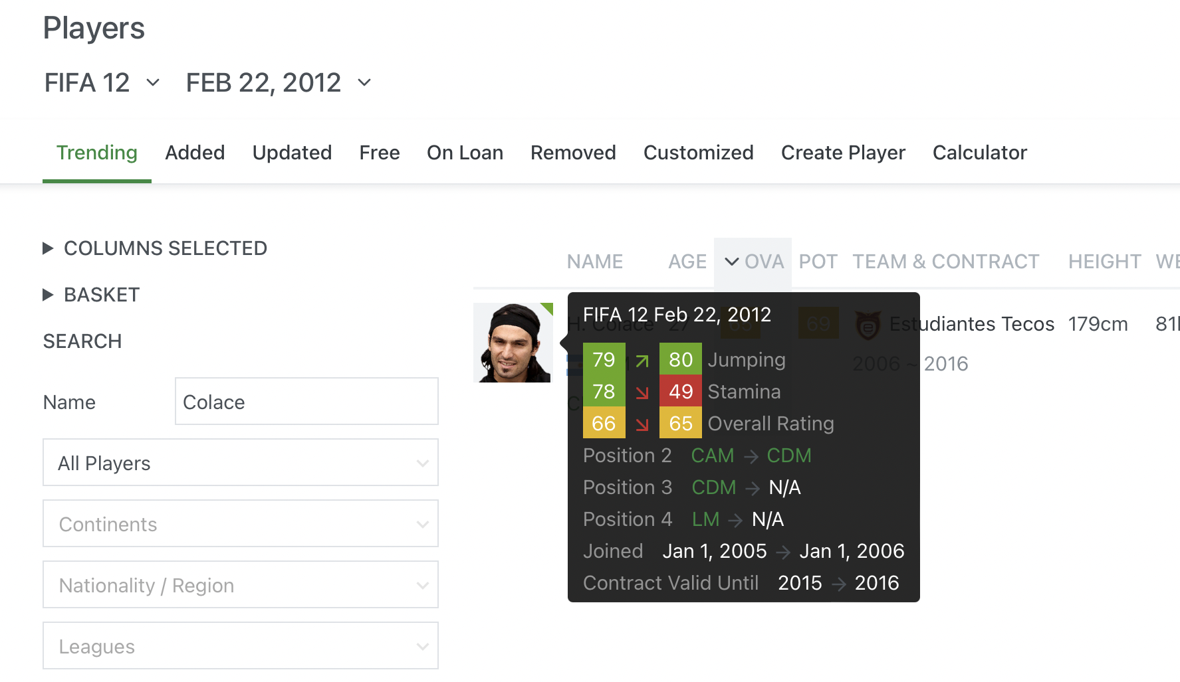

Data Cleaning
There are some ‘N/A’ in the positions
Notes:
As you can see, we noticed the ‘N/A’ in the positions, as the frame has highlighted. And these are related to some statistical problems with the original website page, so we simply delete them in the position columns

Slide 8
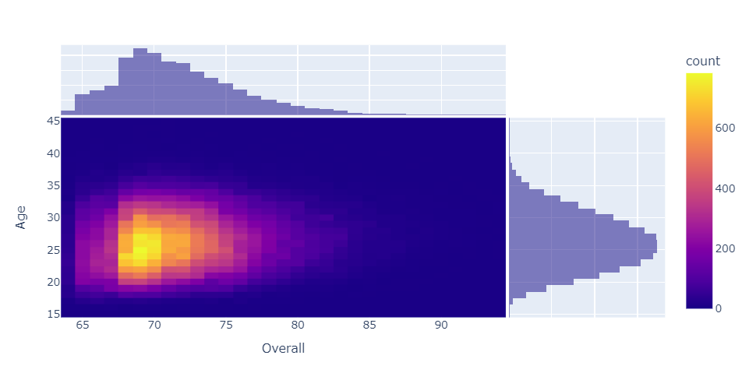
Notes:
This picture demonstrated the correlation between overall abilities and age of the players. The yellow part is with the most density of samples

Slide 9
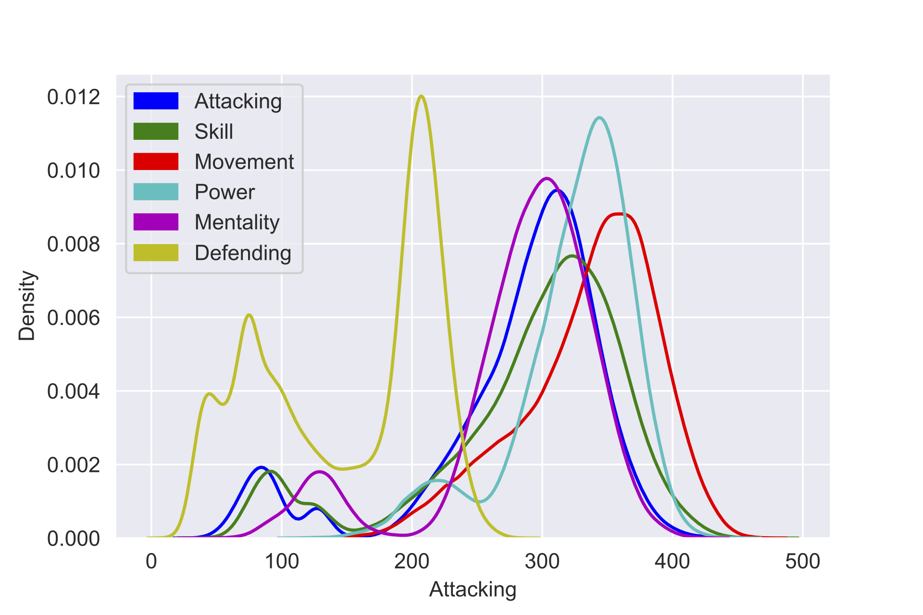

'Attacking’
'Skill’
'Movement' 'Power' 'Mentality' 'Defending’记得换掉
Notes:
This cartogram shows the distribution of players’ different abilities. All the curves have two peaks and this mostly result from the position of Goalkeeper which will be mentioned as GK in the following presentation. Goalkeepers are having totally different ability distributions with players’ in other positions and we put the data from all the positions together to do the algorithm. so the trend of these curves has some conflict with normal distribution.

Slide 10
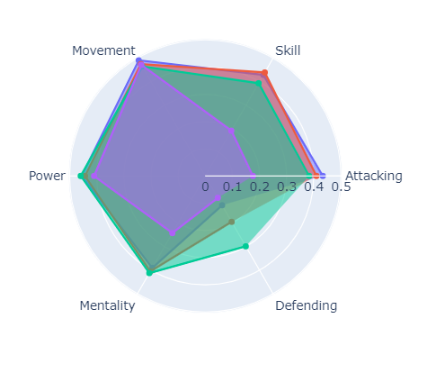
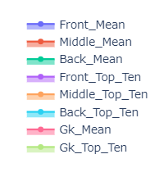
Notes:
We used l2 Normalizer to nomalize the abilities, because the original number is not distinguishing and can not distinguish the differences.
1.Movement and Power are two basic abilities for every players and these two parts don’t have a big difference. Each position if wants to get a good overall grade, it asks to have a grasp of the basic skill. What’s more, the mentality means the player can be calm down and always be confident of winning the match, it doesn’t connect with the position.
2.GK’s six abilities have a big gap comparing with other positions. Goalkeeper is a position different from others. Additionally, as we mentioned, GK has the own standards, such as GK-diving and GK-kicking.

Slide 11
Binary Classification
Binary Classification/ Muti-Label Classification
Support Vector Machine
Logistic Classification

Slide 12
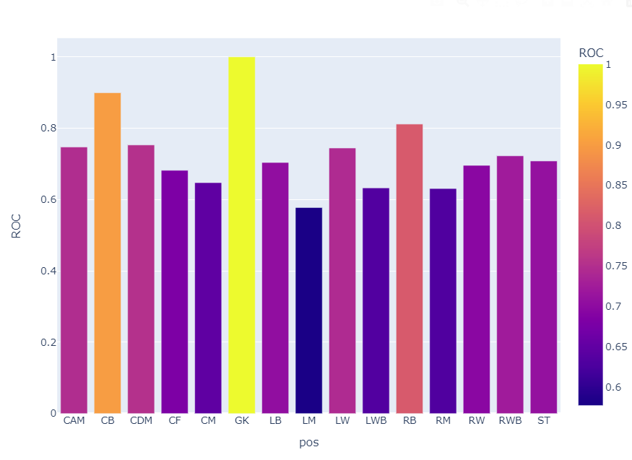
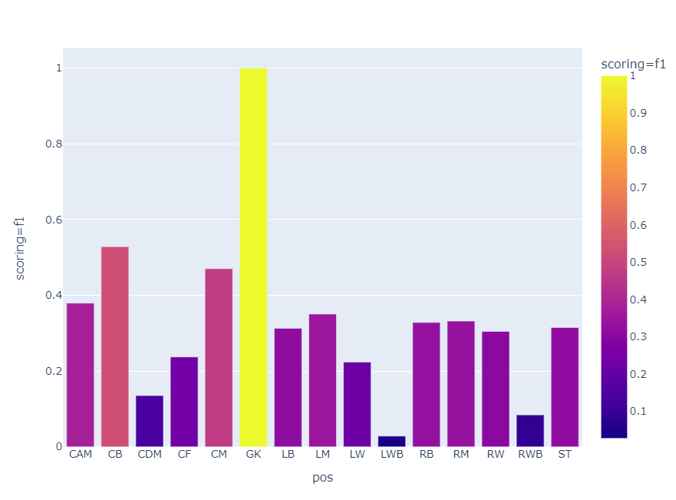
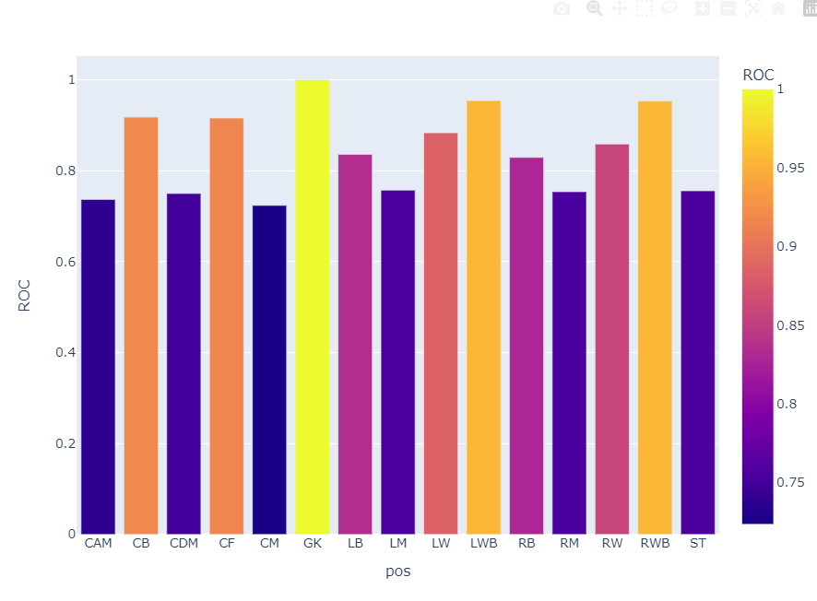
X Gridsearch
scoring = roc-auc, f1, f1-balanced ……

Slide 13

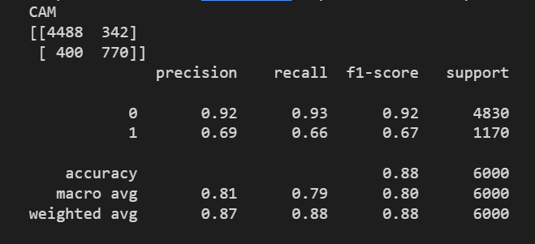
Logistic Classification

Slide 14
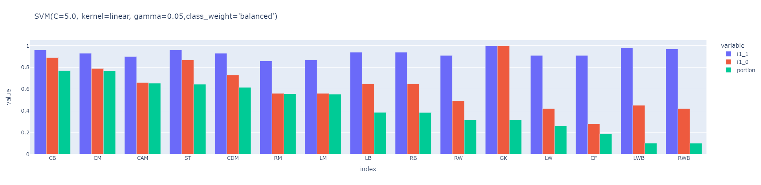
SVM ( kernel = ‘linear’ )
The kernel affects the result most.
Doing much better in linear, poly than sigmod, rbf.
Why: big dataset, lumped(concentrated) data value, large numbers of features

Slide 15
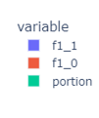
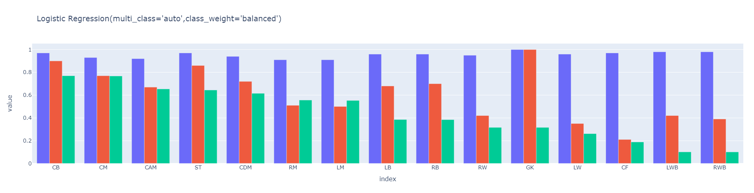
Logistic Classification
Manually adjust the optimal parameter
Findings:
1. Similar results between certain positions
2. f1-score for 0 is positively related to the ratio of 1s/total

Slide 16
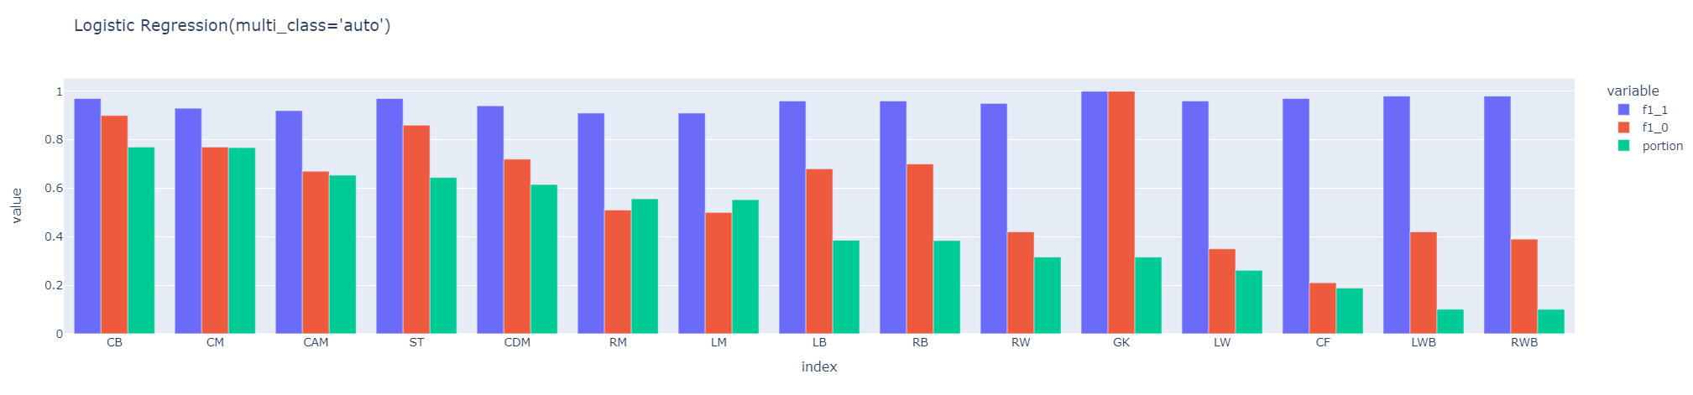
Two assumptions
Similarity between positions
Unbalanced data

Slide 17
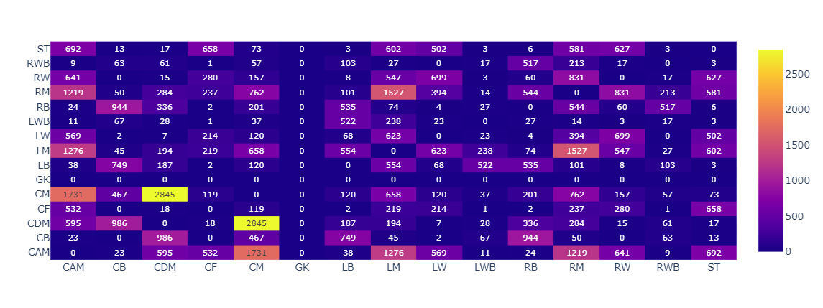
Positions – Popular combinations
The result shows the similarity of different positions.
The higher grades, the more similar.
It is an error analysis to explain why some positions are difficult to predict.
Notes:
We find some players can play not only one position, because statistical chart shows some positions are similar, which means these positions ask the similar individual abilities of the players. For example, Di Maria can play LM and RM, depending on our result, it means there are some connections between some two positions. Additionally, the player's abilities won't be changed by playing in other positions, but their overall grades will do. To sum up, the players can play over two positions shows the similarity between the positions, the overall grades changing shows the different.
How to get the chart?
If a player can play two positions, we will put these two positions together as a combination. We count these combinations together.
We use it to introduce the error analysis.

Slide 18
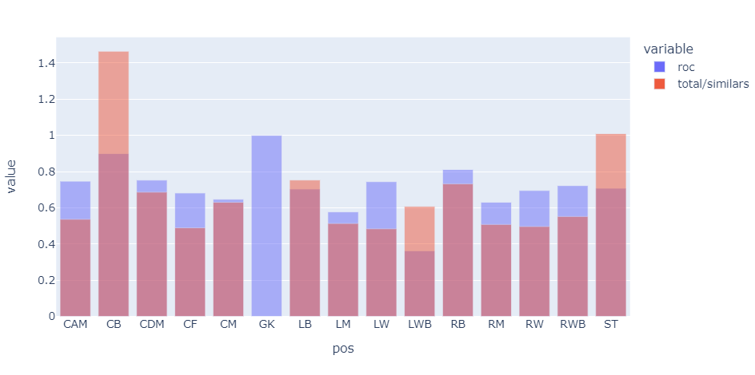
Positions – Similarity evaluation
Notes:
Blue is the roc-auc score, which represents how accurately we can predict a position.
Red indicates the degree a position is similar to other positions,
Which is calculated by the (total number of players)/(number of players who is fit for a certain position)
This can partly explain why some f1-score for 1 ,but not so persuasive.

Slide 19
Unbalanced data – Undersampling
Position | 1 / 0 | LW | 6157 / 72943
CB | 18529 / 60574 | LWB | 2387 / 76713
CDM | 14656 / 64444 | RB | 9328/ 69772
CF | 4485 / 74615 | RM | 13448/65652
CM | 18025 / 61075 | RW | 7447/ 71653
GK | 7479 / 71621 | RWB | 2481/ 76619
LB | 8943 / 70157 | ST | 15225/ 63875
LM | 12950 / 61500 | CAM | 15305/ 63795
A large dataset inhibit overfitting.
Notes:
Because quantity of 0 is greater than 1, so we pick some 0 and make the scale 1:1 to make a balance data. It can decrease the error and improve our prediction. However, our dataset is large, so it won't influence our result.

Slide 20
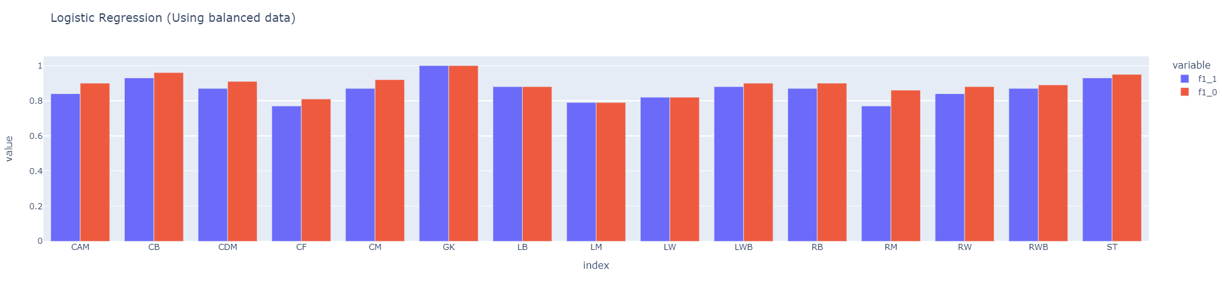
Logistic Classification – Optimized
Notes:
Red: 0's f1-score
Blue: 1's f1-score
First chart shows after using balanced data, red improves, and the results will approach 0.8 and the numbers of 0 and 1 are similar.
Second chart is the result of the unbalanced data.

Slide 21

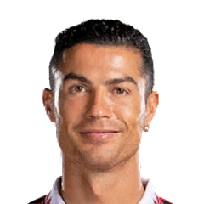

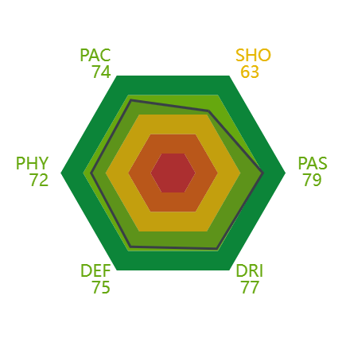
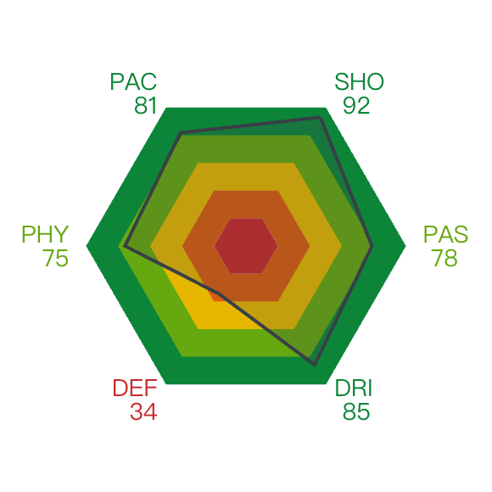
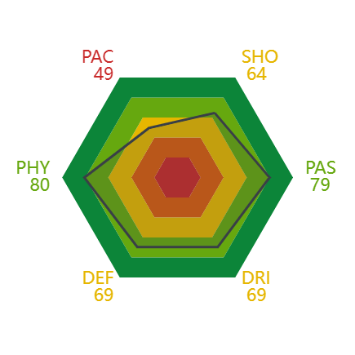
Error Analysis and Model Evaluation
Notes:
1. We still have about 20% of mistaken prediction.
2. Because we compare the capability value vertically, there are three conditions.
3.In first picture, his abilities are balanced but not outstanding. We may put him in 0.
In second picture, he has so many outstanding abilities . We may put him in 1.
Picture 3's player is good at passing and physical, but not good at pace, so he will be counted correctly.
It isn't our algorithm's problems, because it truly happens in reality.

Slide 22
Conclusion
Different positions require the same abilities, but most of them are not.
As a result, we can make a conclusion that if a position has similarities with other positions, this position's prediction will be difficult, and it may be not accurate.
After changing the algorithm, the accuracy has improved a lot( to about 0.8)

Slide 23
Group Member Contributions
Yuchen Song
Realize the algorithm
Predict the positions Binary Classification
Analyze the result
Boyan Zhang
Sculping data from sofifa.com
Multi-threading optimization
Tensorflow inplementation
Yizhi Wang
Analyze the result demonstrated by cartogram
Write paper
PPT making
Baoguanyan Kang
Identify the research direction
introduce to original data
giving the conclusion

Slide 24
References
Retrieved from：
https://www.crummy.com/software/BeautifulSoup/bs4/doc/ https://sofifa.com
https://scikitlearn.org/stable/modules/generated/sklearn.model_selection.GridSearchCV.html
https://scikitlearn.org/stable/modules/generated/sklearn.ensemble.GradientBoostingClassifier.html
https://scikitlearn.org/stable/modules/generated/sklearn.model_selection.GridSearchCV.html

Slide 25
Q&A
Thank you!
Yuchen Song(ys396@duke.edu)
Boyan Zhang(bz106@duke.edu)
Yizhi Wang(yw571@duke.edu)
Baoguanyan Kang（bk220@duke.edu）
25/10

